Slide 1



AI MULTIPLY
PPIE: Public and Patient Involvement and Engagement

Slide 2

contents
Project overview
Project aims
Overview of Work Packages
Collecting Data
Analysing Data
Clinical Interpretation of Data
Successful Collaborations
Health & Social Care Outcomes
PPIE: How you can get involved
PPIE Structure
Overview of meetings
What is involved?
Interviews with researchers
Training of members
Website
Contact information
Queries and feedback

Slide 3
The project
Did you know?
The use of multiple drugs to treat diseases and other health conditions is known as ‘polypharmacy’
Many people live with two or more long-term health conditions
Treating multiple health conditions is a balancing act. People are often prescribed many different medicines together
Sometimes these medicines (and their side effects) can interact in unexpected ways, causing further problems
AI MULTIPLY is an investigation into multiple long-term health conditions and taking multiple medicines
We will look for relationships between multiple conditions, polypharmacy and personal & social factors
The project will run until 31/08/2025

Slide 4
Project aims
To identify early intervention points in the progression of multiple conditions
To define clinical situations when it would be unsuitable for practitioners to prescribe multiple drugs
To use the information gained to create tools which will support clinical decisions, for example a ‘prescribing guide’
To achieve these goals, the project will focus on five different aspects of research, known as work packages

Slide 5
Work package 1
Did you know?
Using artificial intelligence allows us to identify trends in huge amounts of healthcare data
Data engineering describes how researchers prepare the data so it can be analysed
Collecting data
Researchers will make use of multiple, large patient datasets, both national and regional
We will use new developments in computer technology (known as ‘artificial intelligence’, or ‘AI’) to recognise patterns in this data
We will use techniques known as ‘data engineering’ to make it easier to use the data in the next part of the project

Slide 6
Work package 2
Analysing Data
Researchers will use further AI techniques to analyse the data collected in work package 1
At this stage we will start to look for relationships between multiple conditions and polypharmacy
We are particularly interested in how multiple conditions develop over time, and how combinations of medicines can influence this
We will also focus on how specific personal and social factors can affect patient outcomes

Slide 7
Work package 3
Clinical Interpretation of Data
This part of the project will look at how our research can be applied to real-world situations
We will investigate ways to improve healthcare for patients with multiple long-term conditions
This part of the project will be divided into three elements:
Mental health
Inflammation
Observing differences in social factors which may affect the best treatment options for patients

Slide 8
Work package 4
Successful Collaboration of Researchers
This work package will explore how all the different people in the project work together in practice
Successful collaboration of those involved is crucial in designing the AI technology and communicating our findings
This is important as the people in the collaboration bring different kinds of expertise, perspectives and knowledge to the project
As part of this study, we will conduct interviews with researchers and PPIE members

Slide 9
Work package 5
Health and Social Care Outcomes
Research from other parts of the project will identify which people are more likely to experience harm or side effects from their medicines
This final work package will focus on making sure these findings can be used in practice to help improve the treatment of people with multiple long-term conditions
We will focus on clinical and social situations where it may be harmful to prescribe certain medicines

Slide 10
How can you get involved?
Feedback from patients and members of the public who have experience of multiple long-term health conditions and polypharmacy is extremely valuable to our research
We rely on the perspective of people living with or alongside these circumstances to tell us whether the conclusions we draw are valid
We are looking for participants to contribute to the study by attending meetings with other members and researchers throughout the project
Members will be working with an accommodating and inclusive team and full training will be provided
Meetings will be as flexible as possible and can be online or in-person. There will be various opportunities for members to voice their diverse experience and knowledge from the early stages of the project
Participants will receive a £25 voucher for each meeting they attend

Slide 11
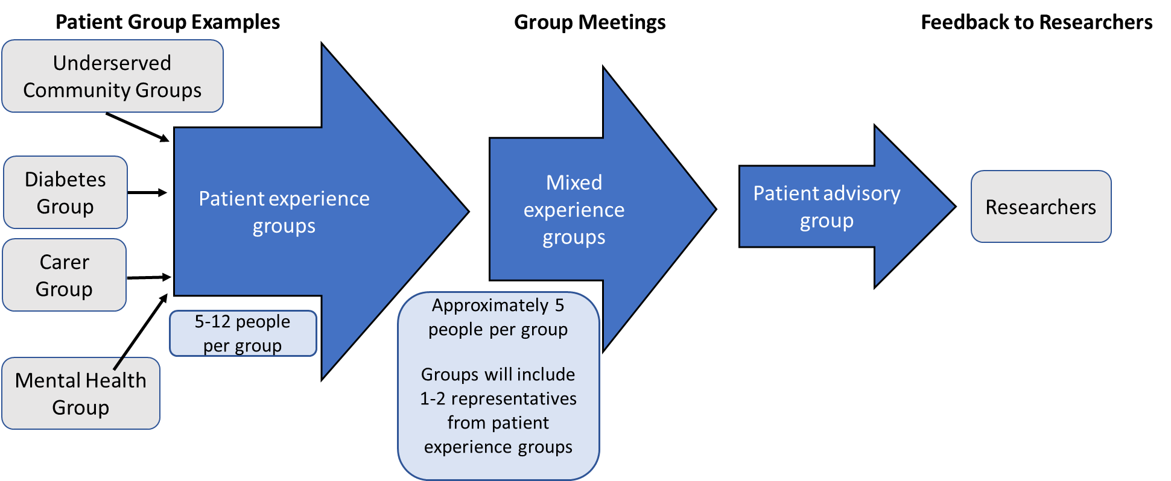
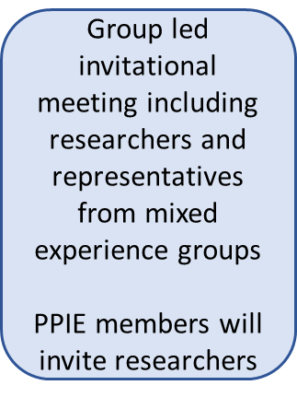
PPIE Structure
The diagram below represents the structure of PPIE meetings with arrows showing the flow of information from patients to the research team
This structure means we can involve a significant number of patients and members of the public, compiling discussion points through smaller, focussed groups and feeding these back to researchers

Slide 12
PPIE Meetings
Meeting | Required Attendees | Frequency | Format
Patient Experience Group | Patients forming groups united by a common theme (i.e. health condition; community) PPIE management team | 6 monthly | Small, informal groups Location will be entirely dependent on participant preferences (online/in person)
Mixed Experience Group | 1 or 2 volunteers from each patient experience group PPIE management team GPs (optional) | 6 monthly | Small, informal groups Location will be entirely dependent on participant preferences (online/in person)
Patient Advisory Group | Researchers (by invitation from PPIE members only) 1 or 2 volunteers from each mixed experience group Other patients and members of the public PPIE management team GPs/pharmacists (optional) | 6 monthly | Formal meetings with an agenda Presentation from researchers and discussion of ongoing research In person Chaired by Olivia Grant 2-hour meetings
GP/Pharmacist | Participating GPs and Pharmacists PPIE management team | 9 monthly | Dependant on participant preferences
Annual Event | All PPIE and project members | Annually | In person, possibly hybrid Conference style Catered Presentation based
PPIE Management | PPIE leads and supporting staff Patients/ public (optional) | Monthly | Online

Slide 13
What will be involved?
There are multiple opportunities for PPIE members to get involved throughout the project
Attendance will initially be required at training sessions over the next few months
Members will attend experience groups which occur every 6 months
Volunteers from initial groups will attend further meetings to discuss experiences with a broader group, and also researchers
Members have the opportunity to attend up to 9 structured meetings per year, plus an annual event and additional sessions where required
The PPIE aspect of the project is broad and will be tailored to members’ preferences and feedback from the very beginning

Slide 14
What will be involved?
Researchers in work packages 3,4 & 5 will carry out interviews with willing PPIE members to capture as much information as possible relating to patient experiences. We aim to:
understand patients’ experiences, perceptions, and priorities
explore real-world differences in the treatment of multiple long-term conditions, the meaning of these differences for individuals, and public perceptions of inequality in healthcare
uncover different methods of recording healthcare data which may be useful in our investigation
We will also conduct follow-up interviews to ensure patients’ real-world experiences and perceptions can influence how we interpret the findings from our research

Slide 15
What will be involved?
PPIE members will form a fundamental part of the AI MULTIPLY team. Your input will be invaluable; only the people whose lives the data represents will be able to tell researchers if their conclusions are valid!

Slide 16
PPIe training
All training needs will be met and PPIE members will be able to give feedback on the training format and content they feel will be most beneficial. Training can include:
Online portfolio of written training documents, such as a glossary of scientific and healthcare terminology
10/15 minute videos to give information on specific topics, such as how research works
In-person training sessions
Online training sessions
Researchers will also attend communication-based training sessions to help us to collaborate as effectively as possible
What training do you feel would be helpful?

Slide 17

Website
Currently in development but will include:
Training materials
News of upcoming project events
Articles covering MLTC-PP for background reading
Plain English summaries of the research/ work packages
Feedback form
To tell us what else you would like to see on the website
Snapshot videos from our team?
A ‘Jargon busting’ glossary?
Blog posts from the team on key topics?
Social media links?
Twitter
Facebook
Instagram
Tiktok

Slide 18
Discussion and Feedback
What are your main concerns?
How can we support you throughout the project?
Do you have any other queries at this stage?
A feedback form will be circulated after the workshop along with the slides from today’s presentation

